Slide 1


Payment Rails
A comparative analysis of Visa and Mastercard:
Market Performance, Risk, and Financial Fundamentals
Nathan Ho

Slide 2
TABLE OF CONTENTS
01
05
02
06
03
07
04
08
Overview
Market Relationships
Market Performance
Market Volatility
Risk vs Return
Key Insights
Financial Performance
Conclusion

Slide 3
Overview
Objective: Analyze and compare market performance, risk characteristics, and financial fundamentals of Visa and Mastercard relative to the S&P 500.
Scope:
Timeframe: 2010 - March 2026
Assets: Visa (V), Mastercard (MA), S&P 500 (^GSPC)
Focus: Market performance, risk, and financial metrics
Approach:
Data ingestion and processing in Python
SQL-based analytics layer for metric computation
Visualization in Tableau and Excel
The code for this project can be found at https://github.com/nathanho27/PaymentRails
Analysis conducted using historical market data through early March 2026

Slide 4
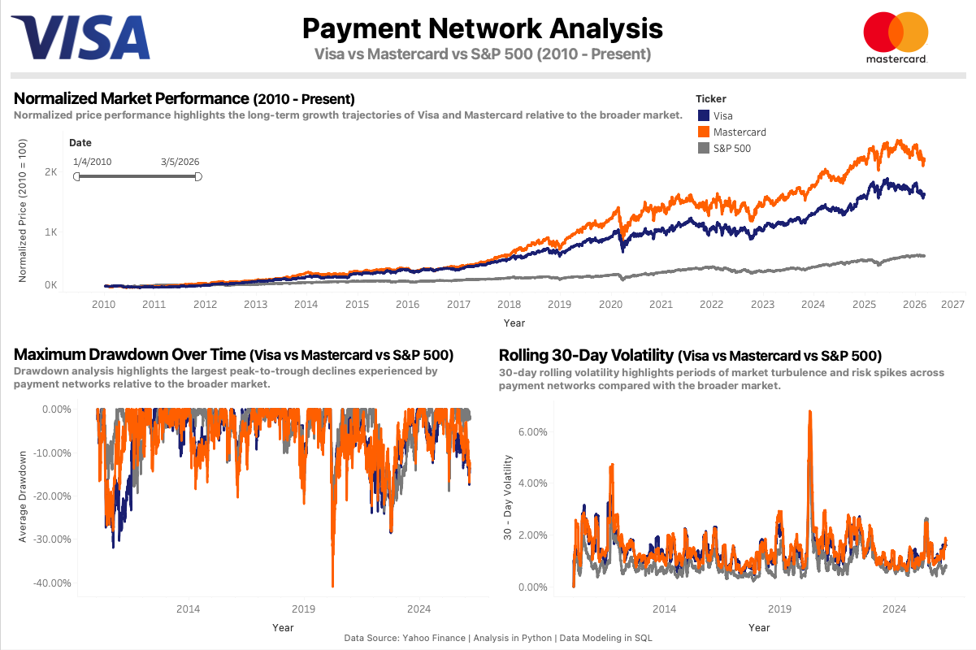
Market Performance
Visa and Mastercard significantly outperform the S&P 500 over long-term horizons.
• Mastercard exhibits slightly stronger cumulative returns over the sample period
• Both firms demonstrate consistent long-term growth driven by scalable network models
• Drawdowns occur but recover more quickly relative to the broader market
Market Performance Dashboard

Slide 5
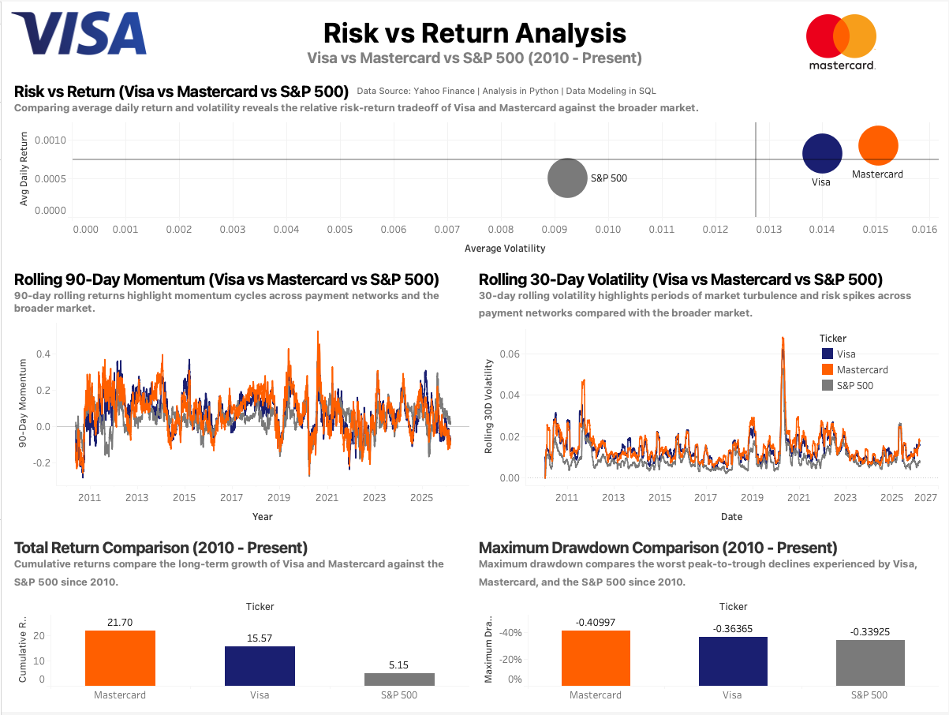
Risk vs Return
Mastercard delivers slightly higher returns but exhibits greater volatility than Visa.
• Both companies outperform the S&P 500 on a risk-adjusted basis
• Mastercard delivers higher returns but exhibits greater volatility
• Visa maintains a more stable risk profile with slightly lower returns
Risk vs Return Dashboard

Slide 6
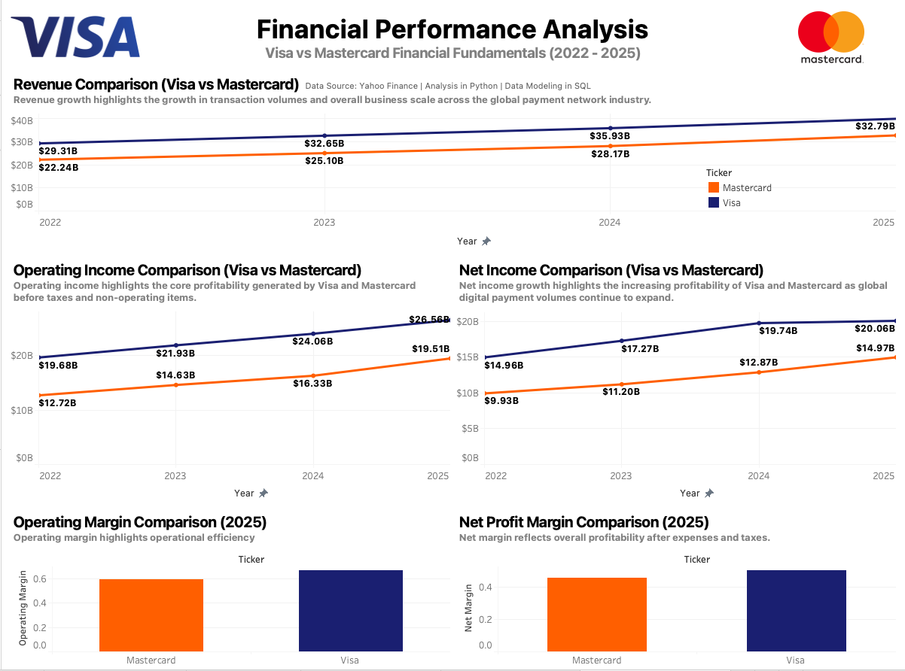
Financial Performance
Visa and Mastercard demonstrate strong revenue growth and high profitability driven by scalable payment network models.
• Both companies show consistent revenue growth driven by increasing global transaction volumes
• Visa maintains higher operating margins, reflecting greater operational efficiency
• Mastercard demonstrates strong profitability growth while slightly trailing Visa in margins
Financial Performance Dashboard

Slide 7
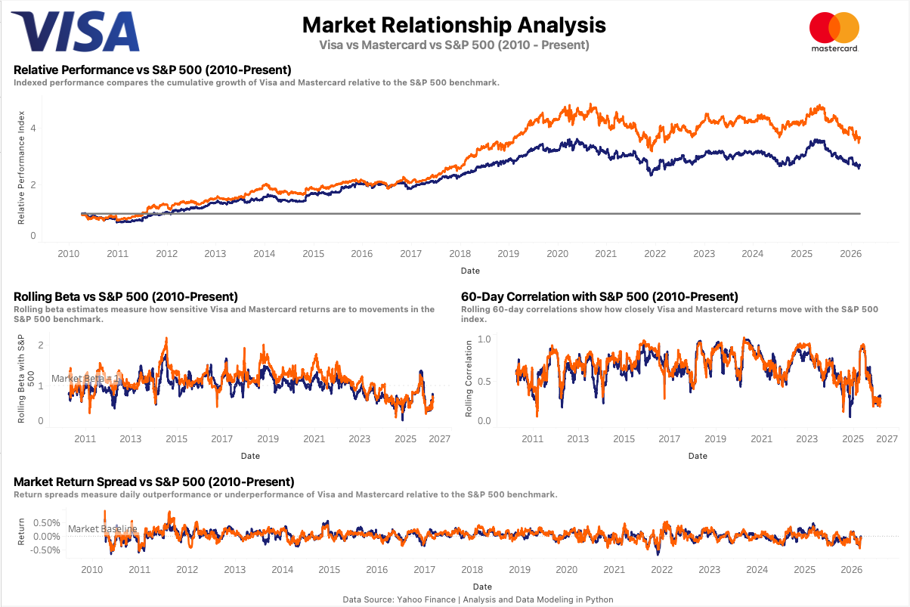
Market Relationships
Visa and Mastercard are highly correlated with the S&P 500 but consistently generate positive excess returns.
• Both companies maintain high correlation with the S&P 500, reflecting strong market linkage
• Beta remains close to 1, indicating sensitivity to broader market movements
• Despite this, both stocks consistently generate positive return spreads relative to the market
Market Relationship Dashboard

Slide 8
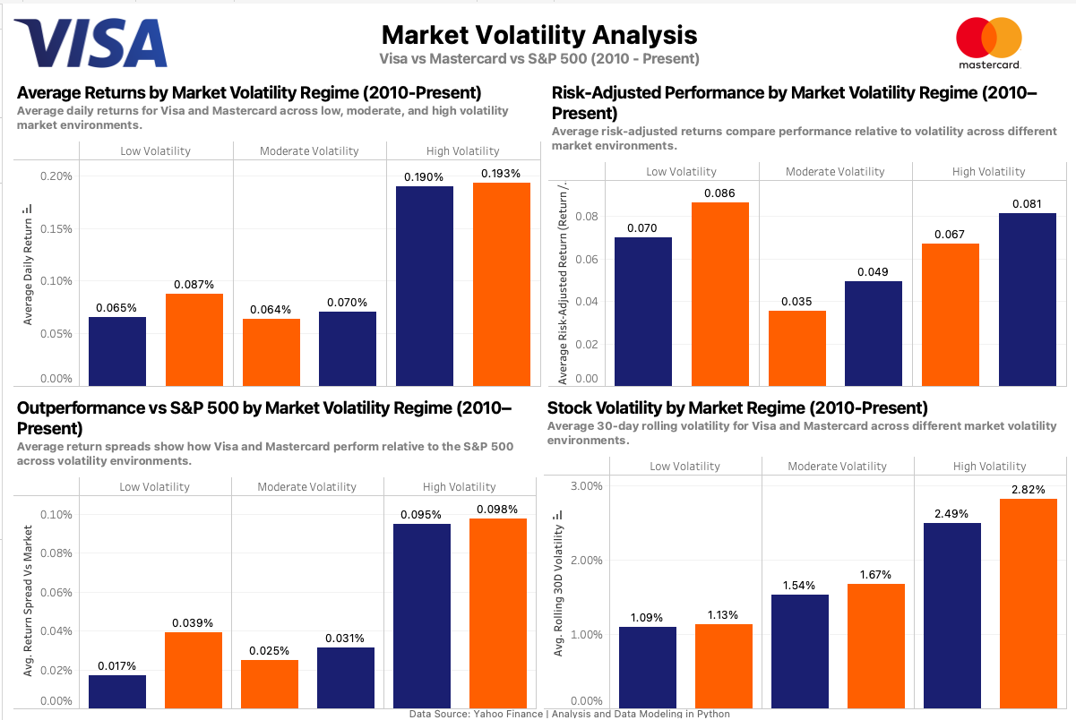
Market Volatility
Visa and Mastercard remain resilient and continue to generate positive returns across different market volatility regimes.
• Both companies generate positive returns in low, moderate, and high volatility environments
• Risk-adjusted performance remains strong even during periods of elevated market stress
• Mastercard exhibits slightly higher returns, while Visa maintains more stable volatility characteristics
Market Volatility Dashboard

Slide 9
Key Insights
• Visa and Mastercard consistently outperform the S&P 500, which suggests their business model provides advantages beyond general market exposure
• Both companies experienced clear drawdowns during major events like the COVID-19 market downturn, but recovered quickly and continued their long-term upward trend
• Even with high correlation and beta close to 1, both companies still generate positive return spreads, showing they’re not just moving with the market
• Mastercard tends to deliver higher returns, but with more volatility, while Visa maintains a more stable and consistent risk profile
• Across different market conditions, both companies continue to generate strong risk-adjusted returns, even during periods of higher volatility
• Strong revenue growth and high margins reinforce how scalable and efficient the payment network model is

Slide 10
Conclusion
Visa and Mastercard demonstrate the strength of the global payment network business model.
Both companies benefit from scalable, asset-light infrastructure and strong network effects, allowing them to generate consistent growth, high profitability, and resilient performance across market conditions.
While Mastercard delivers higher returns with greater volatility, Visa provides a more stable risk profile, and both companies show durable long-term performance continuing to outperform the broader market.
Overall, payment networks represent high-quality, long-term assets within the financial ecosystem.
The code and a more in-depth README for this project can be found at Github

